Slide 1
Conceptual Data Model

Slide 2
Entities

Slide 3
Entities
Member User
Administrative User
Book
Fine
Payment

Slide 4
Entities
Strong Entities
Member User
Administrative User
Book
Fine
Payment

Slide 5
Entities
Member User
Administrative User
Book
Fine
Payment
Weak Entities

Slide 6
Entities
memberid
Member User
password

Slide 7
Entities
adminid
Administrative User
password

Slide 8
Entities
finememberid
Fine
lastupdated
date
total
amount

Slide 9
Entities
pay
memberid
payment
method
Payment
total amount
time

Slide 10
Entities
bookid
yearof
puiblication
Book
category
pagecount
author
title
isbn

Slide 11
Relationships

Slide 12
Relationships
BORROW
RESERVE
HAS
SETTLE
PAY

Slide 13
Relationships
1
Member User
BORROW
duedate
N
Book
1 : N relationship, therefore BORROW uses Book’s key attribute as Primary Key

Slide 14
Relationships
1
Member User
RESERVE
reserve
date
N
Book
1 : N relationship, therefore RESERVE uses Book’s key attribute as Primary Key

Slide 15
Relationships
1
1
Member User
HAS
Fine
1 : 1 relationship, therefore HAS can use either Member user’s or Fine’s key attribute as Primary Key

Slide 16
Relationships
1
N
Member user
PAY
Payment
1 : N relationship, therefore PAY uses Payment’s key attribute as Primary Key

Slide 17
Relationships
1
1
Fine
SETTLE
Payment
1 : 1 relationship, therefore SETTLE can use either Fine’s or Payment’s key attribute as Primary Key

Slide 18
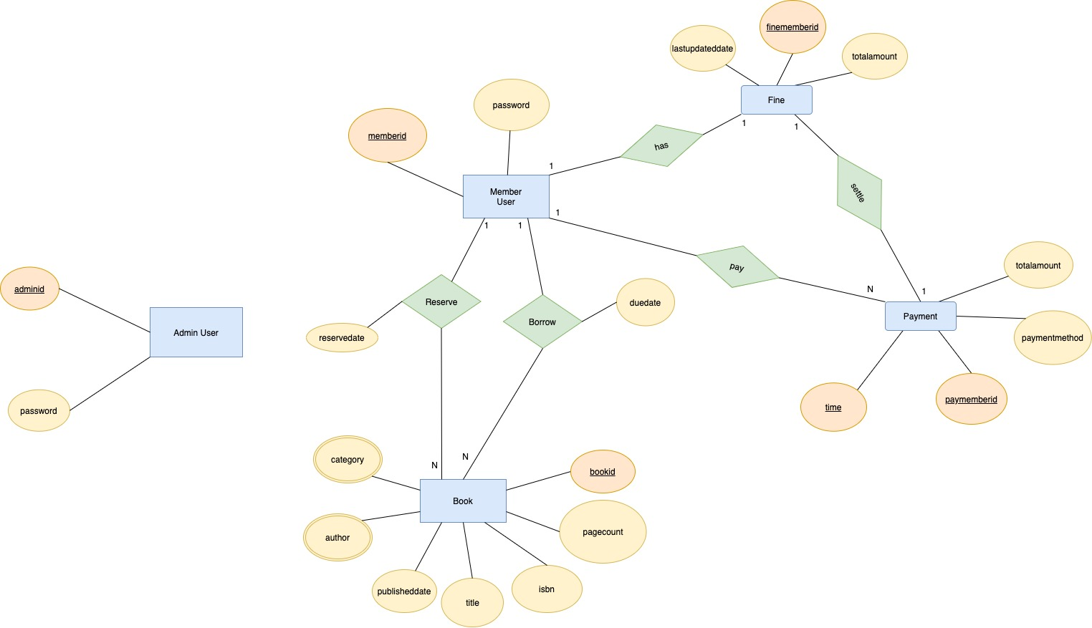

Slide 19
Create Relational Schema

Slide 20
Create relational schemas
RELATION FROM ENTITIES
Admin User | (adminid, password)
Member User | (memberid, password)
Book | (bookid, category, author, pagecount, title, isbn, yearofpublication)
Fine | (finememberid, totalamount, lastupdateddate)
Payment | (paymemberid, time, totalamount, paymethod)

Slide 21
Create relational schemas
RELATION FROM RELATIONSHIPS
Borrow (1 : N ) | (bookid, memberid, duedate)
Reserve (1 : N) | (bookid, memberid, reservedate)
Has (1 ：1) | (finememberid, memberid)
Pay (1 : N) | (paymemberid, time, memberid)
Settle (1 : 1) | (paymemberid, time, finememberid, memberid)

Slide 22
Refine Relational Schema

Slide 23
Multivalued Attributes : Author, Category
author and category are two multivalued attributes in Book
-create new entities Author and Category
Book (bookid, category, author, pagecount, title, isbn, yearofpublication)
Book (bookid, pagecount, title, isbn, yearofpublication)
Author (bookid, authorname)
Category (bookid, categoryname)

Slide 24
Member User – Borrow - Book
Member User – Reserve - Book
Look for opportunities to combine relationships into entities:
Member User - Borrow - Book is a 1:N relationship
Member User - Reserve- Book is a 1:N relationship
-Participation of Book in Borrow and Reserve is total
-Integrate Borrow and Reserve relation into Book
-Primary Key doesn’t change, it is still Book’s PK. But now there is a Foreign Key connecting it to Member User

Slide 25
Member User – Borrow - Book
Member User – Reserve - Book
Member User (memberid, password, totalamount)
Borrow (bookid, duedate, memberid)
Reserve (bookid, reservedate, memberid)
Book (bookid, pagecount, title, isbn, yearofpublication)
Member User (memberid, password, totalamount)
Book (bookid, pagecount, title, isbn, yearofpublication, borrowedid, borrowduedate, reservedid, reservedate)

Slide 26
Member User -- Has -- Fine
Look for opportunities to combine relationships into entities:
Member User - Has - Fine is a 1:1 relationship
- integrate Has relation into Fine
- Primary Key doesn’t change, it is still Fine’s PK. But now there is a Foreign Key connecting it to Member User
Member User (memberid, password)
Has (finememberid, memberid)
Fine (finememberid, totalamount, lastupdateddate)
Member User (memberid, password)
Fine (finememberid, totalamount, lastupdateddate, memberid)

Slide 27
Member User -- Pay -- Payment
Look for opportunities to combine relationships into entities:
Member User - Pay - Payment is a 1:N relationship
- Participation of Payment in Pay is total
- Integrate Pay relation into Payment
- Primary Key doesn’t change, it is still Pay’s PK. But now there is a Foreign Key connecting it to Member User
Member User (memberid, password)
Pay (paymemberid, time, memberid)
Payment (paymemberid, time, totalamount, paymethod)
Member User (memberid, password, totalamount)
Payment (paymemberid, time, totalamount, paymethod, memberid)

Slide 28
Payment -- Settle -- Fine
Look for opportunities to combine relationships into entities:
Payment - Settle- Fine is a 1:1 relationship
- integrate Settle relation into Payment
- Primary Key doesn’t change, it is still Payment’s PK. But now there is a Foreign Key connecting it to Fine
Payment (paymemberid, time, totalamount, paymethod, memberid)
Settle (paymemberid, time, finememberid, memberid)
Fine (finememberid, totalamount, lastupdateddate, memberid)
Payment (paymemberid, time totalamount, paymethod, finememberid, memberid)
Fine (finememberid, totalamount, lastupdateddate, memberid)

Slide 29
Member User - Book
Look for opportunities to examine dependency in entities
In Book entity, borrowduedate is not dependent on bookid alone,
but dependent on (bookid and borrowedid) and is CALCULATED field
Same for Reserve
So there is Transitive dependency in Book
take borrowedid, borrowduedate, reservedid, reservedate out into BORROW and RESERVE
Member User (memberid, password, totalamount)
Book (bookid, pagecount, title, isbn, yearofpublication, borrowedid, borrowduedate, reservedid, reservedate)
Member User (memberid, password, totalamount)
Borrow (bookid, duedate, memberid)
Reserve (bookid, reservedate, memberid)
Book (bookid, pagecount, title, isbn, yearofpublication)

Slide 30
Our Final Schema
Admin User | (adminid, password)
Member User | (memberid, password)
Book | (bookid, pagecount, title, isbn, yearofpublication)
Author | (bookid, authorname)
Category | (bookid, categoryname)
Fine | (finememberid, totalamount, lastupdateddate, memberid)
Payment | (paymemberid, time, totalamount, paymethod, memberid, finememberid)
Borrow | (bookid, duedate, memberid)
Reserve | (bookid, reservedate, memberid)

Slide 31
Logical Data Model

Slide 32
Logical Data Model
Member User (memberID, password) Primary Key memberid
Admin User (adminid, password) Primary Key adminid
Author (bookID, authorname) Primary Key bookid, authorname
Book (bookid, pagecount, title, isbn, yearofpublication) Primary Key bookid
Category (bookid, categoryname) Primary Key bookid, categoryname
Borrow (bookid, duedate, memberid) Primary Key bookid Foreign Key memberid references Member User (memberid)
Reserve (bookid, reservedate, memberid) Primary Key bookid Foreign Key memberid references Member User (memberid)
Fine (finememberid, totalamount, lastupdateddate, memberid) Primary Key finememberid Foreign Key memberid references Member User (memberid)
Payment (paymemberid, time, totalamount, paymethod, memberid, finememberid) Primary Key paymemberid, time Foreign Key finememberid references Fine (finememberid) Foreign Key memberid references Member User (memberid)

